Slide 1


Se 1 RC Java Advanced Patterns
Patrick Wilson-Welsh

Slide 2
Introduction
Patrick Wilson-Welsh
Senior Consultant
Pillar Technology Group
http://pillartechnology.com
pwelsh@pillartechnology.com
http://patrickwilsonwelsh.com
http://coderetreat.ning.com/
mobile: 248 565 6130
twitter: patrickwelsh
blog: patrickwilsonwelsh.com
https://github.com/PillarTechnology/SeleniumPatterns

Slide 3

I’m here to help …

Slide 4
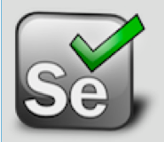
Selenium is the leading open-source tool for automated web application testing. Used well, it can do things other testing tools cannot. Used poorly, it can cause enormous headaches.
Notes:
4

Slide 5
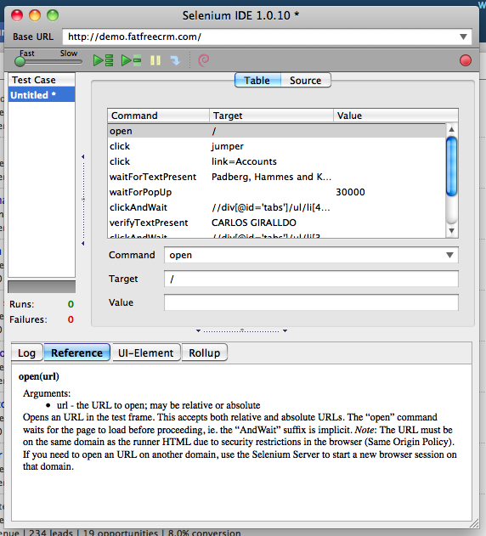
Se IDE
Notes:
5

Slide 6
Se IDE: Adam, Please Remove the Save Feature Don’t use Se IDE except for prototyping Hand-roll Object-Oriented Se RC tests
Notes:
6

Slide 7
Selenium RC allows you to write Se tests in several languages, including Java. It allows you to write decent OO Se test code as you would write OO production java. But its API is not inherently OO. It allows you to write Se test code as if it was really bad Fortran. Migrating from Se IDE to Se RC: especially dangerous.
Notes:
7

Slide 8
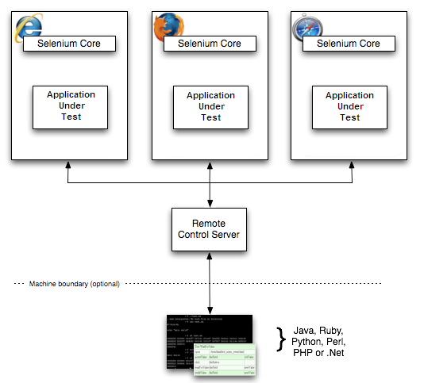
Se RC
Notes:
8

Slide 9
Example 1: Bad-Ole Se 1 RC Multi-Page-Flow Procedural code for verifying that the same links show up on each of several pages. Even method extraction and custom assertions may not help as much as you need.
Notes:
9

Slide 10
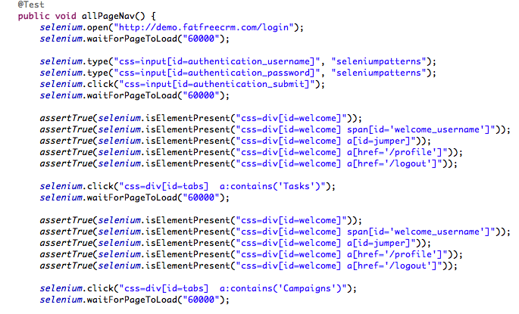
Notes:
10

Slide 11
Domain-Specific Languages (DSLs) How many different domain semantics are being mixed up in the above code? How many abstraction layers are coupled? I’m abusing the term to mean, roughly, semantics or APIs or collections of modules that fit within certain domain boundaries. I care much more about DSL boundaries than I do about their level of fluency (and I love natural-language fluency).
Notes:
11

Slide 12

Separable Concerns, Layers, DSLs in Se Testing?
Tests: Biz Value
Page Sequence
Page Traversal
Element Location/ Manipulation
DOM Traversal
Page/Element Verification
HTTP Semantics
Dynamic/RIA Semantics
Se API
Java
Notes:
12

Slide 13
Don’t Mix All The Food Coloring. You Get Brown.
Page Sequence
Java
Tests: Biz Value
Page Traversal
Element Location/ Manipulation
DOM Traversal
Page/Element Verification
HTTP Semantics
Dynamic/RIA Semantics
Se API
Notes:
13

Slide 14
Problems When you Mix the DSLs -- Noisy tests -- Coupling/poor cohesion. -- Brittle tests -- Shotgun surgery
Notes:
14

Slide 15
Problems When you Mix the DSLs -- Obscure page-flow and page verification. -- Messy state verification. -- Dynamic HTML/Ajax problems -- Inconsistent element locator strategies -- Very slow execution on some browsers
Notes:
15

Slide 16
A concern-separation principle to consider for Se testing: DRY, reusable test framework.
Self-Verifying
“Page Objects”
Generic HTML Element Objects
Parameterized “Link Objects”
Se Façade/ Decorator
Notes:
16

Slide 17
src source folder: DRY reusability src folder (or wherever) contains only reusable domain-specific and domain-independent classes.
Notes:
17

Slide 18
src source folder: DRY reusability Domain-specific pages, panes, and common components (nav menus, etc). These use the natural biz/page DSL. Domain-independent framework (page elements/controls, Selenium and jQuery façade/decorator, locator strategy code)
Notes:
18

Slide 19
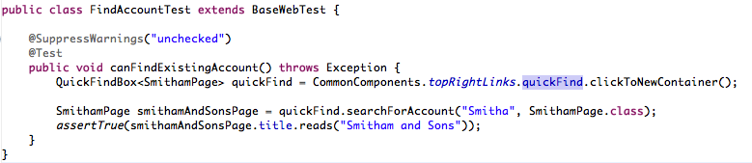
A DSL-separating principle to consider for Se testing: “Wet”, one-off test code.
Notes:
19

Slide 20
test source folder: one-off, wet test code DSL: Page Flow as Business Domain test folder contains behaviorally-organized test scenarios. Nearly all of them happy paths. Test scenarios for page flow manipulation and state verification can include quite a bit of duplication. If you prefer, extract private helper methods like “loginAndNavigateToSuchAndSuchPage()”
Notes:
20

Slide 21
Specific patterns in the selenium-rc-patterns eclipse project.
Notes:
21

Slide 22
Pattern: Reusable Element Objects Framework
Different kinds of page elements get matching classes; all extend BaseElement.
All are completely generic; unrelated to biz domain.
Notes:
22

Slide 23
Pattern: Reusable Selenium Singleton Facade
All access to DefaultSelenium and SeleniumServer (Jetty HTTP proxy) are outside test code.
All access to them is via singleton inside façade
Façade decorates DefaultSelenium with other cool stuff you need
Notes:
23

Slide 24
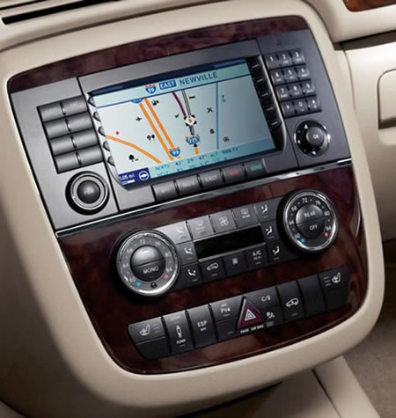
Pattern: Self-Verifying Page Objects: they Know When They Have Arrived
Notes:
24

Slide 25
Pattern: Self-Verifying Page Objects
Biz-domain-specific classes wrap the behavior of specific pages in your app, in page-specific ways.
When you navigate to a page by clicking on a link, the matching page object gets launched, and waits until it is fully loaded by that object’s definition (a css element selector).
Notes:
25

Slide 26

Pattern: Encapsulated Link Semantics
Notes:
26

Slide 27
Pattern: Encapsulated Link Semantics
When you instantiate a DhtmlLink class, you parameterize it with the PageObject.class that you want to be launched when you click on that link.
This pushes page flow semantics deep into the actual link flow, emulating actual app, and keeps page flow DRY.
Notes:
27

Slide 28
Remember the good old days of every browser-resident change resulting from an HTTP Response to an HTTP Request? (Sigh.)
Notes:
28

Slide 29
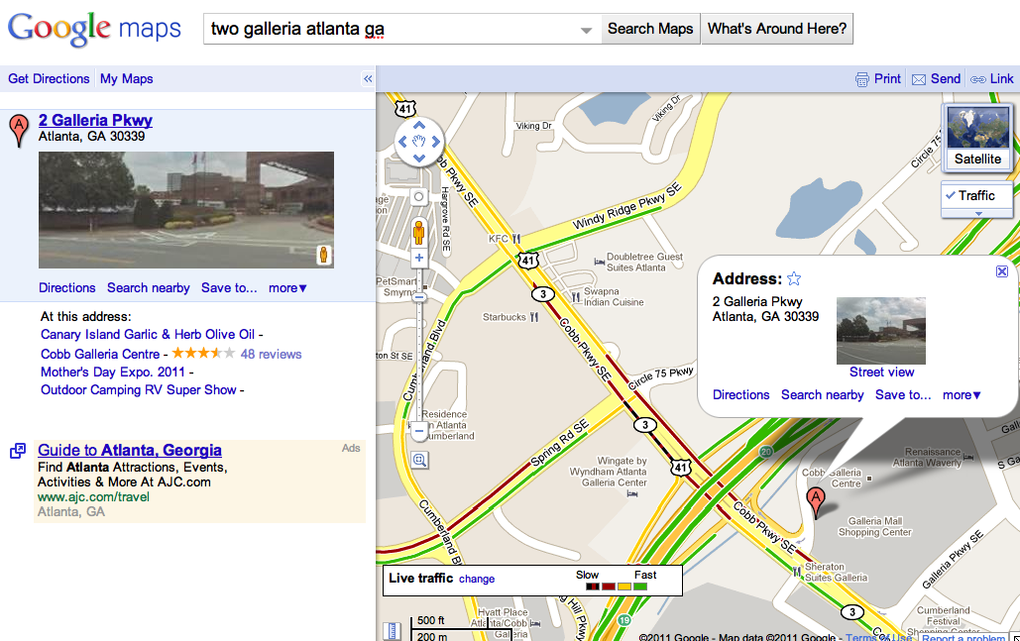
Whole desktops, coming to browsers near you…
Notes:
29

Slide 30
Principles to consider for testing dynamic stuff: The rendered HTML is less and less your friend. XPATH is not standard, thus not your friend. The in-memory DOM is your friend. CSS element location strategy is your friend. jQuery is your friend.
Notes:
30

Slide 31
Pattern: CSS Element locator strategies for DHTML/Ajax
Use id or name attributes if you got ‘em
Use css as a second-resort locator
Only use xpath as a last-resort element locator
Actually, forget it. Never use xpath.
Notes:
31

Slide 32
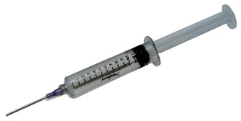
Pattern: Using jQuery to Verify Dynamic Visibility
Consider usingSe to inject jQuery (or some such js library) into a page, to get direct access to the DOM, not the rendered HTML, to verify dynamic changes.
Notes:
32

Slide 33
Pattern: Using jQuery to Verify Dynamic Visibility
There will increasingly be behaviors for which jQuery, being cross-browser in a fairly standard way, is a better choice for DOM state verification than older techniques
Notes:
33

Slide 34
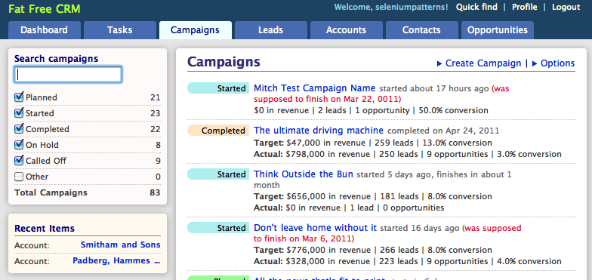
Pattern: Common Page Element Singletons
Notes:
34

Slide 35
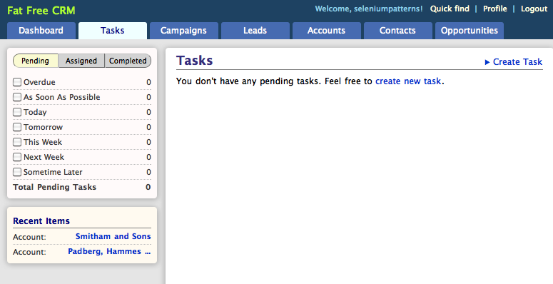
Pattern: Common Page Element Singletons
Notes:
35

Slide 36
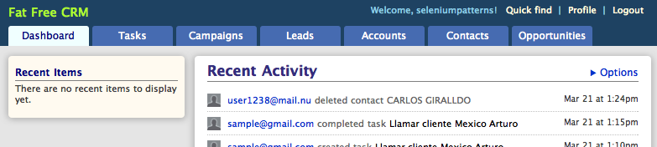
Pattern: Common Page Element Singletons
Notes:
36

Slide 37
Pattern: Common Page Element Singletons
If all pages (or groups of pages) in an app all share certain common elements, consider hanging a static singleton off a BasePage object for all pages, or for that group of pages.
Notes:
37

Slide 38
How hard is it to regression test an entire enterprise web app using any web-app-GUI-black-box testing tool?
Notes:
38

Slide 39

too hard: avoid
Notes:
39
How is it hard? Let’s look at a metaphor...

Slide 40
Number #1 Reason Selenium RC, through the web app GUI tests are so brittle and expensive to maintain?
Notes:
40

Slide 41
Because you are writing too many of them. Let me put that another way.
Notes:
41

Slide 42
You are committing too high a percentage of total test-automation and programming resources to that specific kind of automated testing.
Notes:
42

Slide 43
“Driving on the ice in in blizzard in Michigan.” Avoid it whenever you can. Know how to do it well.
Notes:
43

Slide 44
What is Selenium not good at testing? -- Every functional app path (JUnit instead) -- Discrete app behaviors (JUnit instead) -- Javascript behaviors (Jasmine instead) -- All view layer behaviors -- Browser-vendor-neutral behavior (HTMLUnit) -- Automated Acceptance Testing (BDD Tools)
Notes:
44

Slide 45
What is Selenium good at testing? The browser-resident app behaviors you cannot test any other way. It is your tool of last resort. -- Testing a few full-stack happy paths -- Browser-compatibility testing -- Tricky view behaviors -- Automated functional demos -- Demo BDD (with Cuke or JBehave on top) -- Policing load-time thresholds
Notes:
45

Slide 46
If you are committing too high a percentage of total test-automation and programming resources to Se testing… …have a plan for outgrowing that pattern. Actually, have a fairy tale:
Notes:
46

Slide 47

3 kinds of automated tests
Notes:
So we are here to talk test automation, and three little kinds of it. Brick tests, Stick tests, and Straw tests. And we are here to talk about the best mix to have, and how it takes time to get to that best mix.

Slide 48

GUI end-2-end, integration, story, acceptance, BDD unit/micro/isolation
Notes:
At the top, our straw tests are those that test the system as a black box, through its GUI. In this presentation, we’ll mainly be talking about automated testing solutions for web applications, not rich client apps, BTW. At the bottom, we have programmer tests: unit tests that isolate bits of behavior. And in the middle, our stick tests do not go through the GUI, but typically test much more of the system than our unit tests do.

Slide 49
TCO
% of automated testing work
Notes:
At the top of the triangle, we have the tests that are most expensive to maintain. At the bottom, we have the tests that are least expensive to maintain. The width corresponds to how much of our total testing resources budget we want to dedicate to the different kinds of tests. So what are they, exactly?

Slide 50
good: least investment/ROI good: most investment/ROI
Notes:
In our ideal triangle, again, we want most of our time and money for automated tests going into the unit tests. And we want the least of it going into the through-the-GUI tests.

Slide 51
least rework & waste; lowest TCO
Notes:
In theory, this gives us the lowest Total Cost of Ownership, because it gives us the least amount of rework and waste. It detects the most bugs the cheapest, it drives the best software design, it verifies features most efficiently, and it is least expensive to extend and maintain. So let’s explore these contentions.

Slide 52

But that’s not your triangle, yet, perhaps.
Notes:
52

Slide 53
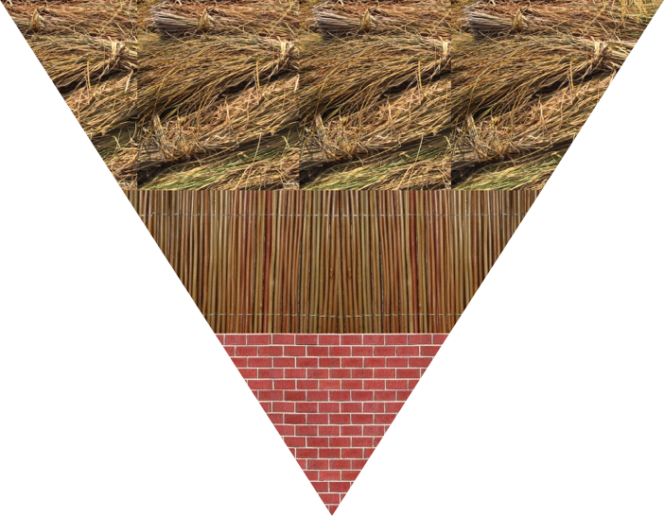
we often start here
Notes:
And our initial automate testing triangle actually looks more like this. We are throwing too much time and money into through-the-GUI automated tests. And we are throwing far too little time, money, skill, and discipline into really good unit tests.

Slide 54
good: easy to learn
bad: hard to learn
for good reason!
Notes:
And we should forgive ourselves for this, because the ideal triangle is hard to achieve.

Slide 55
bad: high TCO, low ROI
good: low TCO,
high ROI
But again, the price
Notes:
And we should forgive ourselves for this, because the ideal triangle is hard to achieve.

Slide 56
Summary Use Se less. Use Se only for what it is good at. Treat Se RC code with OO respect. DRY framework; “wet” tests Watch out for Se 2; it is a game-changer.
Notes:
56

Slide 57

Get this book...
Notes:
57

Slide 58

…and this book.
Notes:
58

Slide 59
Q/A

